Slide 1
Modelling
Design and Manufacture
Name: ………………………………………………………… Class:……………… Teacher:…………………………………………..

Slide 2
What is modelling in Design and Manufacture?
Designers present their ideas to the user, client and manufacturer as models, mock-ups, prototypes and computer generated 3D models.
Model - a scaled down graphic representation of a design.
Prototype - a life size working model of a design used for testing development and evaluation.
Mock-up - a model of a product built for study, testing and display
Computer Generated 3d modelling – modelling software is used to create a realistic rendered model of the product.
Model making can be a very quick and cheap method of producing a prototype. Suitable materials include paper, card, foam board, styrofoam™, wire and 3mm MDF.
Users, clients and manufacturers use models to evaluate ideas and decide how well they meet their needs and how best to make it.

Slide 3
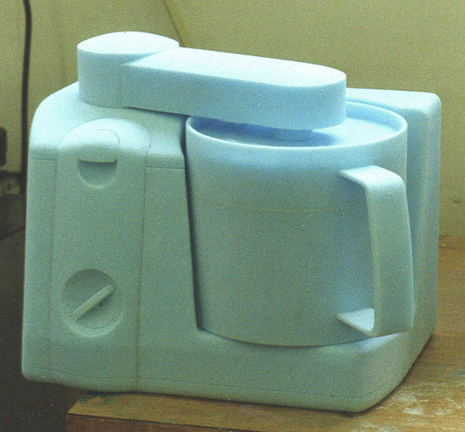
Modelling - Styrofoam
There are many ways to build models. Some materials are more suited to making a certain type of model than others.
Styrofoam—This material is good for making block models as it is very easy to cut and form into thick 3D shapes.
Styrofoam comes in large sheets, which commonly range from 25mm to 110mm thick and is usually coloured blue or
pink. Styrofoam can be cut using a craft knife, fine bladed saw or hot wire cutter and shaped using sand paper, files or a
surform. When cutting or sanding styrofoam, a dust mask and eye protection must be worn.
http://youtu.be/YINmKrCynhU
Example of a Styrofoam model

Slide 4
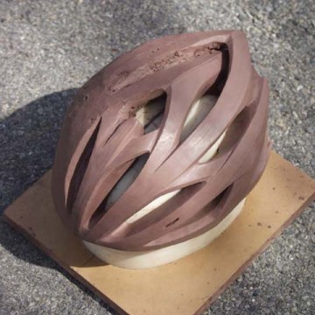
Modelling – Clay
Clay—This material is good for making block models and more complicated models as it is very easy to cut and form into thick 3D shapes.
One mayor advantage of using clay is that if you make a mistake or change the design, this can be easily done by adding or taking more clay away.
http://youtu.be/eUz75_8gPs0
Example of a Clay model

Slide 5
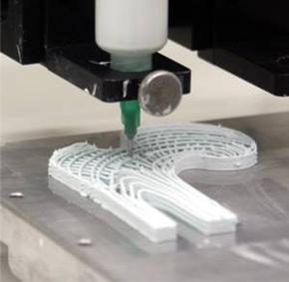
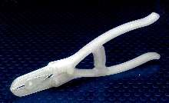
Modelling – Rapid Prototyping
What is Rapid Prototyping
Rapid prototyping is the name given to a number of processes used to turn CAD models into 3D objects very
quickly.
The process is normally carried out on a 3D printer which uses plastic such as ABS to construct the model. The printer melts the plastic through a nozzle onto a base board into the shape of the product. The printer does this a layer at a time building up into the completed model.
http://youtu.be/1gzkCuLGzn0
Example of a rapid prototype model
Nozzle on a 3D printer layering the ABS

Slide 6
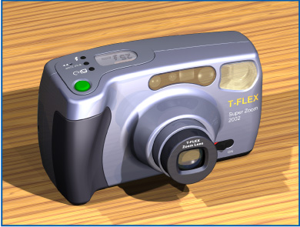
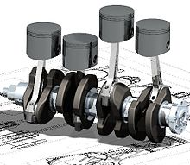
Computer Generated 3D Modelling
Computer 3D Modelling - The development of 3D modelling software enables designers and engineers to create realistic 3D models of their designs.
A 3D computer model is a virtual object which can be rotated on screen and viewed from any angle.
Advantages of computer 3D modelling
Models can be produced very quickly.
Models can be modified very easily.
You can easily add colour & surface texture.
You can test structural designs before building eg bridges & skyscrapers.
Easily sent by email to remote locations throughout the world.
Less storage space required than a ‘real’ model.
Used to create realistic simulations.
Clients can explore virtual ‘walk through’ of 3D model designs.
Disadvantage of Computer 3D modelling
Computer generated models are virtual and can lack the feel of a traditional model which can be picked up and handled.

