Slide 1
Key fob
KIRSTY WEIGHILL

Slide 2
STEP 1 MASKING TAPE
COVER THE UNPROTECTED SIDE/S OF YOUR PLASTIC WITH MASKING TAPE
THE REASON WE COVER IT WITH MASKING TAPE IS :
FOR PROTECTION THROUGHTOUT THE CONSTRUCTION
YOU CAN MARK ON MEASURMENTS WITHOUT ACTUALLY MARKING THE PIECE OF PLASTIC !

Slide 3
STEP 2 MEASURMENTS
WITH A PENCIL MARK ON THE MEASURMENTS FOR YOUR KEYFOB ON THE MASKING TAPE
MAKE SURE EVERY ANGLE IS RIGHT SO WHEN YOU CONSTRUCT THE KEY FOB IT IS PERFECT

Slide 4
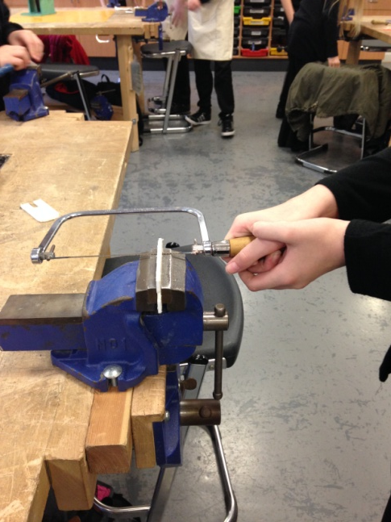
STEP 3 USING COPING SAW
PLACE YOUR PIECE OF PLASTIC IN THE VICE
USE THE COPING SAW AND SAW THROUGH THE PLASTIC UNTIL YOUR MARKED LINE
DO THIS FOR ALL OF THE ANGLES YOU WANT TO CUT OUT/REMOVE

Slide 5
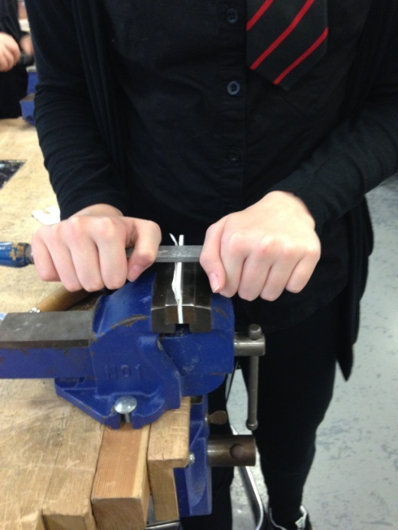
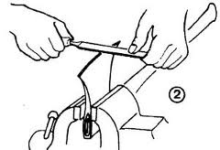
STEP 4 DRAW FILING
MAKE SURE YOUR PLASTIC IS IN THE VICE
WHEN DRAW FILING MAKESURE THAT THE DRAW FILE IS GOING HORIZONTALLY AND YUOR HANDS ARE AT EITHER SIDE LIKE THIS
WITH THE DRAW FILE GO
FORWARDS AND
BACKWARDS QUITE
QUICKLY FOR A
NICE SMOOTH EDGE

Slide 6
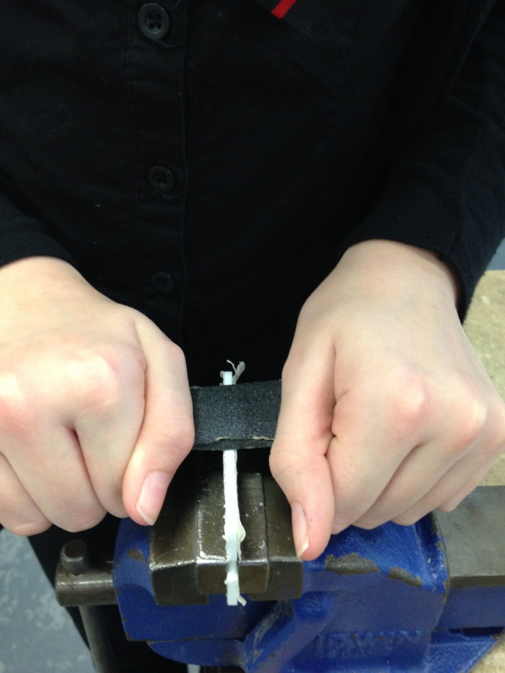
STEP 5 WET AND DRY PAPER
GET A PIECE OF WET AND DRY PAPER
RUN IT UNDER WATER
WRAP THE PAPER
ROUND YOUR DRAW
FILE AND DO THE SAME
AS YOU DONE WITH
DRAWFILING BUT THIS
TIME WITH THE WET
AND DRY PAPER

Slide 7
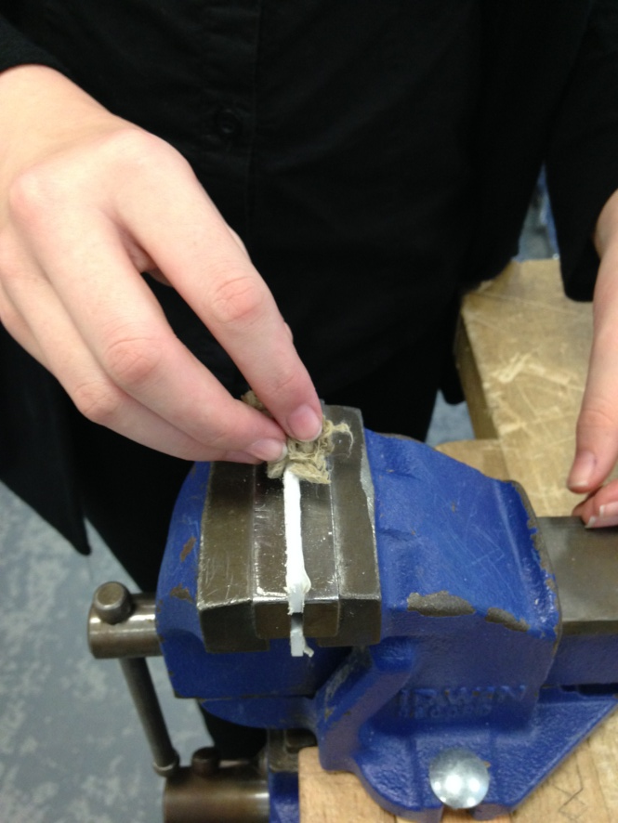
STEP 6 BRASSO
COLLECT A PIECE OF BRASSO
PLACE YOUR PIECE OF PLASTIC IN THE VICE
RUB REALLY HARD WITH
THE BRASSO ON THE EDGES
OF YOUR KEYFOB

Slide 8
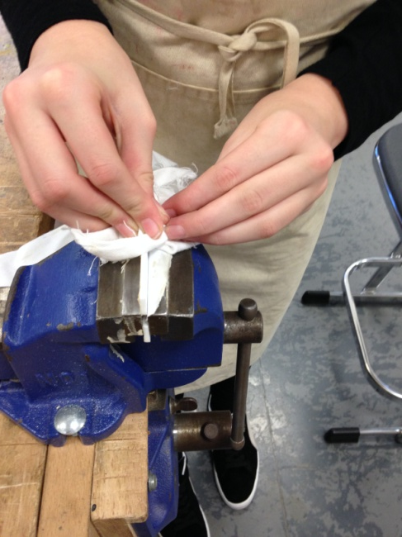
STEP 7 CLEAN OF BRASSO
COLLECT A PIECE OF CLOTH
PLACE YOUR PLASTIC IN THE VICE
RUB REALLY HARD LIKE YOU DONE WITH BRASSO BUT THIS TIME MAKE SURE ALL THE EDGES ARE SHINY AND THAT THEY REFLECT

Slide 9
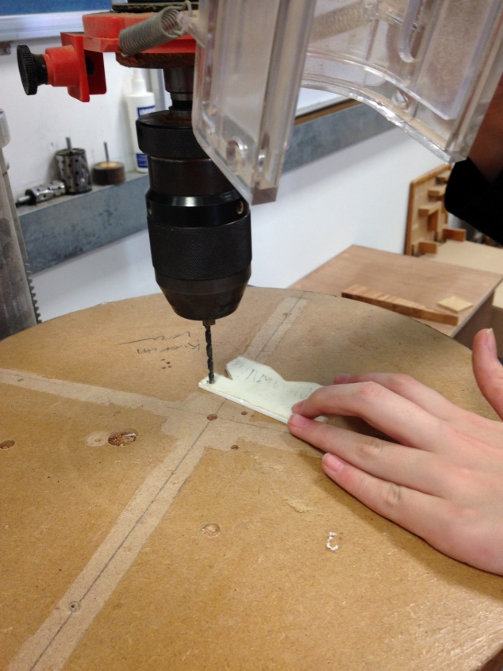
STEP 8 DRILL HOLE
MARK ON YOUR MASKING
TAPE WHERE YOU WOULD
LIKE YOUR HOLE TO BE
DRILLED
SLOWLY BRING THE DRILL DOWN AND DRILL THROUGH THE PALSTIC
MAKE SURE YOU ARE WEARING GOGGLES AND ARE DRILLING ONTO A FLAT SURFACE !!!!!

Slide 10
STEP 9 REMOVE MASKING TAPE
SLOWLY REMOVE THE MASKING TAPE FROM YOUR PLASTIC
IF THERE ARE ANY GLUE MARKS ON THE PLASTIC THEN JUST RUB THEM WITH BRASSO THEN WIPE WITH A WHITE CLOTH

Slide 11
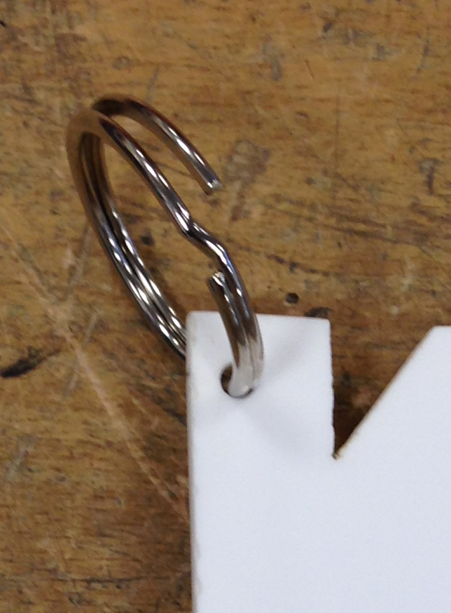
STEP 10 ATTACH RING
ATTACH YOUR RING TO YOUR DRILLED HOLE

Slide 12
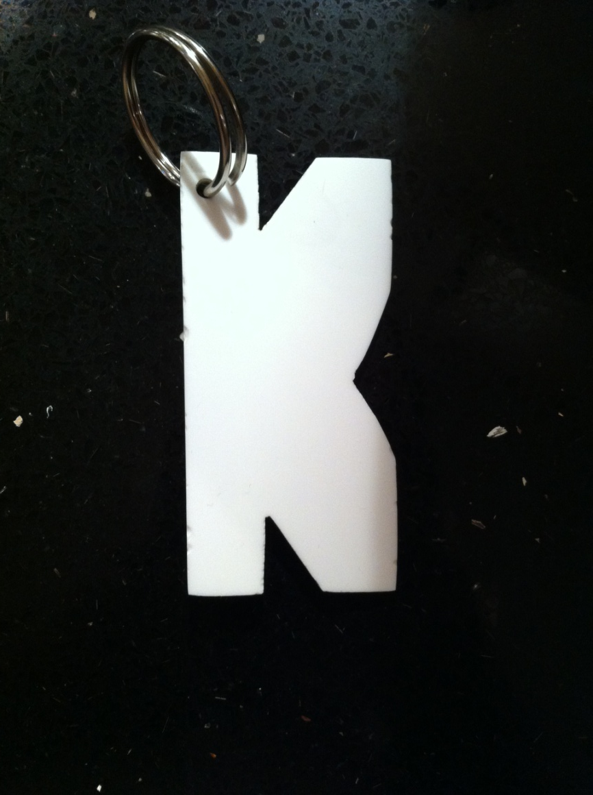
MY KEY FOB MY FINISHED KEY FOB

